Slide 1
ASFASDFASDFSADF
ASDSADASD

Slide 3
标题1
标题2

Slide 5
A Closer Look at SoftLayer, an IBM Company
Notes:
On July 8th 2013 IBM closed on the acquisition of SoftLayer, an IBM Company. SoftLayer delivers a unique set of world class capabilities – that together with the technology and business expertise and experience of IBM sets IBM in a whole different class than competitors on the market today.

Slide 8
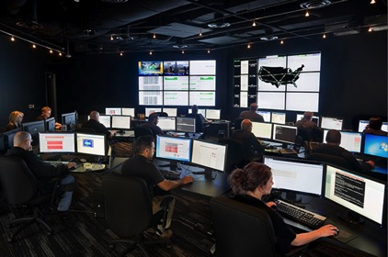
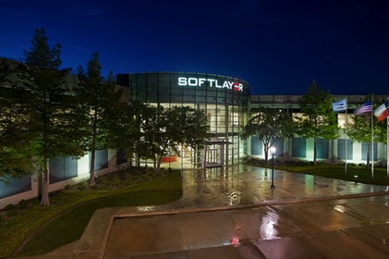
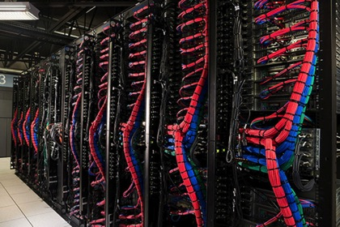
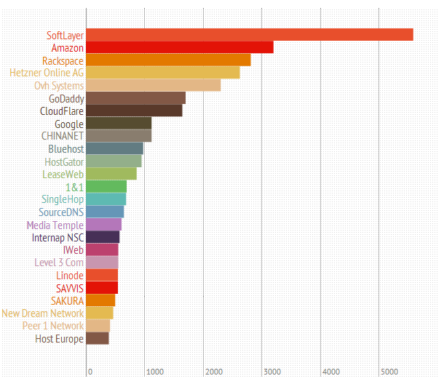
A global hosting leader
Customers | 21,000 in 140 countries
Devices | 100,000
Employees | 685
Data centers | 13
Network PoPs | 17
Top 100,000 Sites
By Hosting Provider
Source: Hostcabi.net
Notes:
Let’s start by introducing SoftLayer, an IBM Company. SoftLayer is one of the largest cloud infrastructure providers in the world, with more than 100,000 devices under management for 21,000 customers in 140 countries. SoftLayer operates a global footprint of 13 data centers and 17 network points-of-presence around the world, filled with servers, storage, routers, firewalls and load balancers. But the heart of this service isn’t servers or network cables. It’s a software platform that provides a complete operating system for the data center – that automates every aspect of infrastructure as a service – and that allows us to deliver the industry’s broadest and highest performing cloud platform.
A brief history – SoftLayer was founded in 2005 by a team of technology and business leaders with a wealth of experience providing managed hosting and infrastructure services. Their vision was to build a new kind of on-demand hosting company, driven by software automation and sophisticated management tools – cloud computing before the term was widely used, you might say.
By 2013 SoftLayer had become a global company with a management team comprised of seasoned hosting and cloud computing leaders; the market leader in Web hosting and home to more of the world’s top 100,000 sites and apps than any other provider. In July we were acquired by IBM, combining our leadership and innovation in cloud with the technology industry’s global innovation leader.

Slide 9
A working definition
Cloud (n) On-demand compute with consumptive billing
On-demand Rapidly provisioned services
Compute Servers, network, storage, firewalls, ancillary services
Consumptive billing Turns traditional fixed IT costs into variable – monthly or hourly
Initial model – virtualized multi-tenancy computing – does not meet requirements for 100% of applications and use cases
For broadest applicability, user-selectable levels of performance and isolation are required
Notes:
There are a couple of things that make SoftLayer a very different company from a product and philosophy standpoint, and the first, inevitably, requires a quick discussion of cloud computing from a definitional standpoint.
It's tempting to dismiss "the cloud" as marketing hype – a meaningless term applied to a bewilderingly broad range of solutions – but cloud computing at the infrastructure level actually has a clear definition. Some would try and narrowly tailor that in terms of a mandatory technical reference architecture – x virtualization software on y hardware platform – but that's going too far in the other direction, and an approach generally advocated by organizations who have a vested interest in the manufacture and sale of a particular component.
Our own view, and it aligns with prevailing definitions published by organizations including the National Institute of Standards and Technology (NIST) and Gartner, is that cloud infrastructure can best be defined as an operational model for the delivery of computing-as-a-service across a network in a way that provides capacity on demand from a pool of computing resources that provides significant scalability and rapid elasticity, consumption-based pricing, and self-provisioning.
While the initial cloud revolution was centered on virtualized, multi-tenancy clouds, this is only one model of compute, and one that isn’t necessarily well suited to the full breadth of workloads, use cases and industries. As cloud has mainstreamed and matured, organizations are increasingly looking to take advantage of the power of consumptive, real-time computing without compromising performance, security and control. They want to choose when to use virtualization and when not, control precisely where their infrastructure is physically located and shape their infrastructure to their application, not shoehorn their app into someone else’s idea of the right platform.

Slide 10
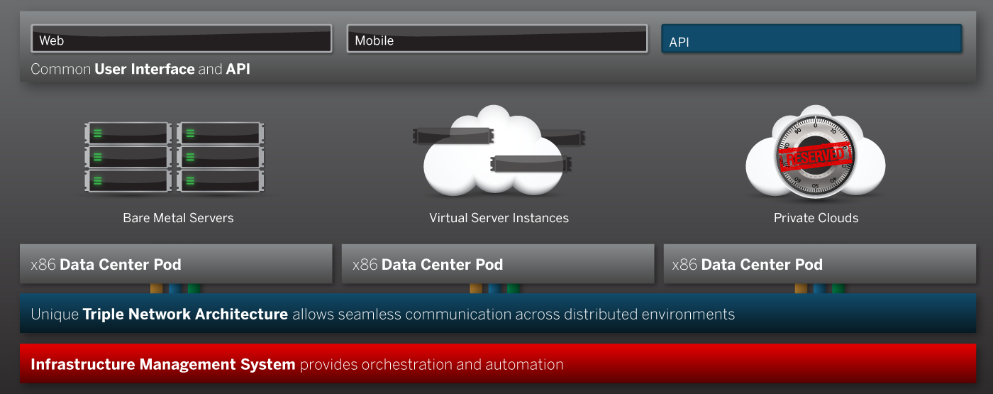
A better platform Unified architecture with common management and programming interfaces
Common command and control interface across a unified architecture
Combine bare-metal servers, public cloud instances and private cloud deployments into distributed hybrid architectures and manage from a single control pane and API
All deployed on-demand and provisioned in real-time
Ideally suited to big data deployments, high I/O and latency-sensitive apps
Notes:
SoftLayer, uniquely, has designed and deployed a global, interconnected platform that meets the key operational and economic requirements of cloud infrastructure across a broad portfolio of infrastructure - dedicated and shared devices, physical and virtual servers, hourly compute instances and four-way, octo-core bare metal, along with a wealth of storage, networking and security components.
Our customers can take these building blocks and deploy public cloud instances, build private clouds on their choice of virtualization stack, leverage the raw power of bare metal on demand, or combine these solutions into distributed, hybrid architectures. Build what you want, or leverage our turn-key big data and private cloud solutions to design and deploy complex, scalable infrastructure online in real time. It’s all delivered as a unified service, managed from a single pane of glass via our Web portal or mobile apps, and accessible via a powerful, full-featured API. One bill, one portal, one platform.
It's a model that provides users with a greater range of choice, flexibility and control than any other cloud infrastructure solution in the industry.

Slide 11
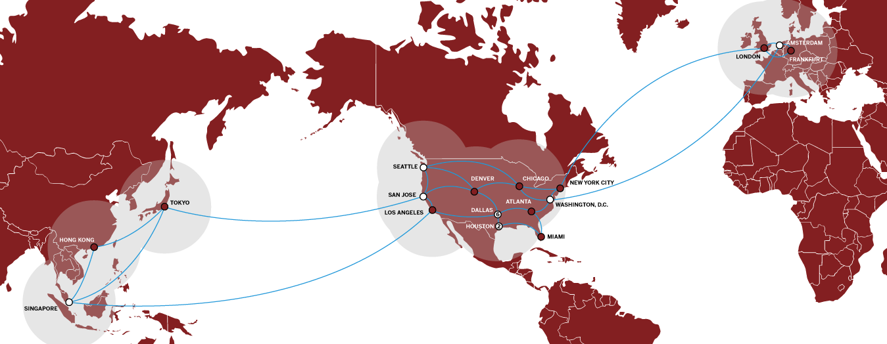
Global footprint
13 data centers
17 network PoPs
Global private network
21,000
22,000,000
100,000
SERVERS
CUSTOMERS
DOMAINS
Notes:
So how do we do it? We operate 13 data centers around the world. We’ve augmented that core footprint with additional network points of presence in Tokyo, Hong Kong, Frankfurt, London and several locations within the United States, with the goal of delivering a sub 40 millisecond experience to our customers and their customers across as wide a footprint as possible.
These network points of presence and our global private network allows customers in Tokyo to connect at one hop away from infrastructure in Singapore or San Jose, and allow customers to deploy cloud instances in Amsterdam and bare metal in Houston yet allow them to communicate with each other across the same network segment as if they were in the same rack together.

Slide 12
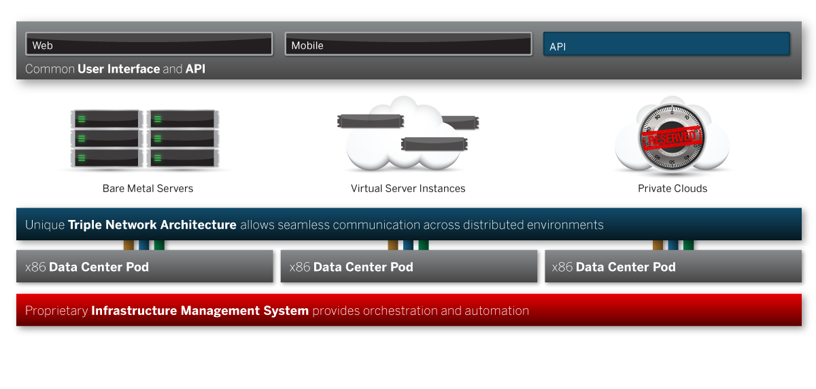
Infrastructure building blocks
pod
bare metal
virtual instances
local storage
triple network architecture
network storage
object storage
Notes:
How the service primitives are defined and linked to create offerings

Slide 13
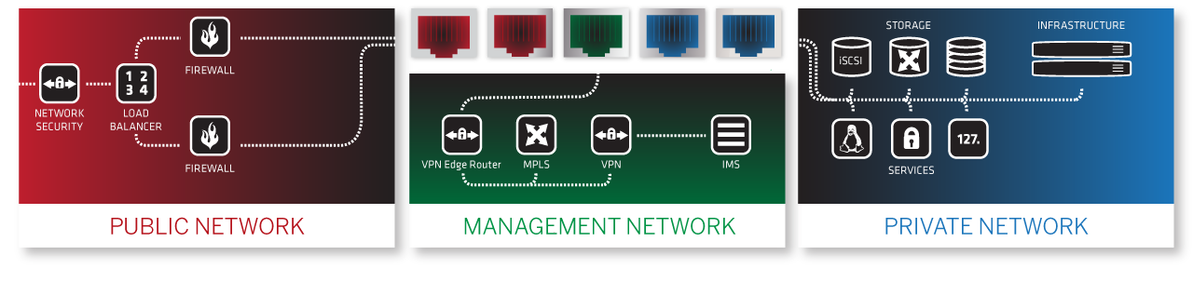
Triple-network architecture
High-performance public network with transit from multiple tier-1 carriers
Secure OOB management via VPN
Private network for intra-application and inter-facility communications, access to shared services
Native IPv6 support
Virtual racks for integrated management
Complete suite of network services
Notes:
Let’s talk a little more about the network – it’s perhaps the fundamental component in terms of performance, yet it’s rarely discussed in detail by hosting providers. We’ve made a significant investment at SoftLayer in building a network of networks; we think our network architecture and performance stand alone in the industry.
Each physical server has five network cards. Two redundant connections to the public network, which aggregates connectivity from multiple tier 1 network providers for performance and redundancy. Two more NICs provide redundant connections to our global private network, providing secure point-to-point intra and inter data center connectivity along with access to a suite of SoftLayer services including storage platforms, DNS, security scans and OS reload services.
A final network connection provides access to an out-of-band management network for access to our management platform and API.
The entire network and services stack provides native support for IP version 6, ensuring that as this critical transition takes place over the next few years, you’ll be well ahead of the game.

Slide 14


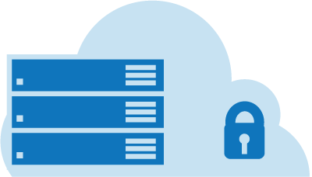

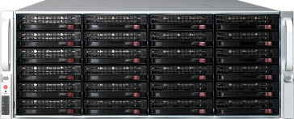


Standardized, modular infrastructure One platform, myriad solutions to serve a broad range of customer requirements for performance, isolation
Highly flexible architecture
One platform for public cloud servers, private clouds, bare metal servers
Complete integration
Unified systems management & API
Technology-neutral platform
Support for broad range of operating systems, virtualization platforms
Build hybrid, distributed, high-performance architectures and manage from a single pane of glass
Pay by the hour or the month for a truly variable IT operations model
Hybrid Clouds
Private Clouds
Public Clouds
x86 Server
?
Bare Metal
Virtual Servers
Notes:
On top of this triple network architecture we’ve deployed a highly standardized and modular compute platform. Row upon row of x86 server sits patiently waiting to be pressed into service. You can deploy virtual instances into a shared public cloud environment, build high-performance dedicated servers or provision private clouds with your choice of several different virtualization stacks. Connect virtualized and bare metal, leverage onboard storage – SAS, SATA or SSD – SAN and NAS solutions or build on top of our global Object Storage platform. Add firewalls and load balancers for security and availability.
Provision everything from a robust management portal or build autoscaling functionality directly into your app via our API. Deploy physical or virtual from a unified, image-based server provisioning system, and organize your infrastructure into Virtual Racks for ease of management and communication.
You can start with a virtual server, snapshot with our Flex Images technology and instantly deploy a mirror image on a physical device – all the necessary conversion happens behind the scenes. Go the opposite direction and move from dedicated to virtual, or leverage a suite of features on bare metal – such as server cloning and image-based deployment – previously available only on a virtualized platform.

Slide 15
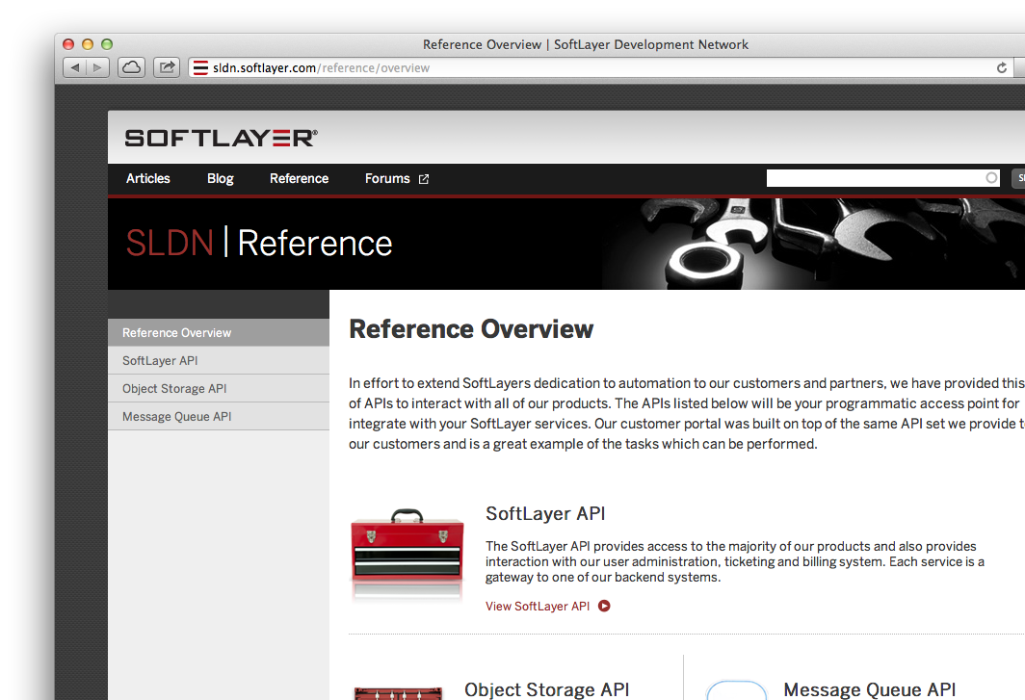
Robust, full-featured API
Improves customer control, reduces error, increases flexibility
SoftLayer API provides 1,600 function calls to over 200 services
Supports REST, SOAP & XML-RPC interfaces
Enables full auto-scaling implementations
Comprehensive documentation, libraries and support
Functions include:
Automatic server deployment
Service provisioning
Reboots & reloads
Ticketing
Hardware configuration
Software load
DNS
Network
Storage
Security scans
Monitoring
Notes:
The heart of the platform, and indeed the heart of SoftLayer, is automation. We automate for a number of reasons; chief among them to improve customer control and transparency, reduce human error and optimize costs and agility. The SoftLayer API provides control over more than 200 services including server acquisition, reboots and reloads, network and storage configuration, security and systems monitoring. We support REST, SOAP and XML-RPC interfaces and our online SoftLayer Development Network provides support, code samples and documentation to get you up and running quickly.

Slide 16
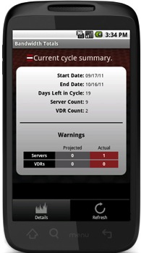
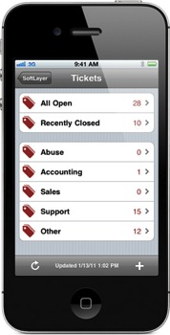
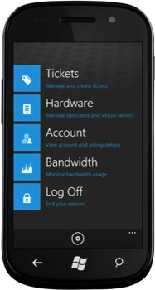
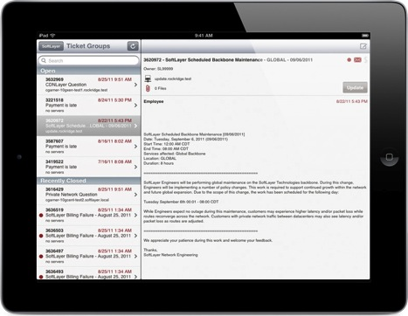
Complete control
Mobile and Web-based management portals
Purchase, provision, deploy & manage infrastructure
Access to services, tools, automation & tutorials
Secure access via VPN to management network
Two-factor authentication to Web portal
Notes:
In addition to the API, (and built on top of it), we’ve got a full-featured, secure Web-based portal for complete management of your infrastructure. We’ve also got mobile apps available for all the leading devices including iPhone and iPad, Android smartphones and tablets, and Windows Mobile devices.

Slide 17
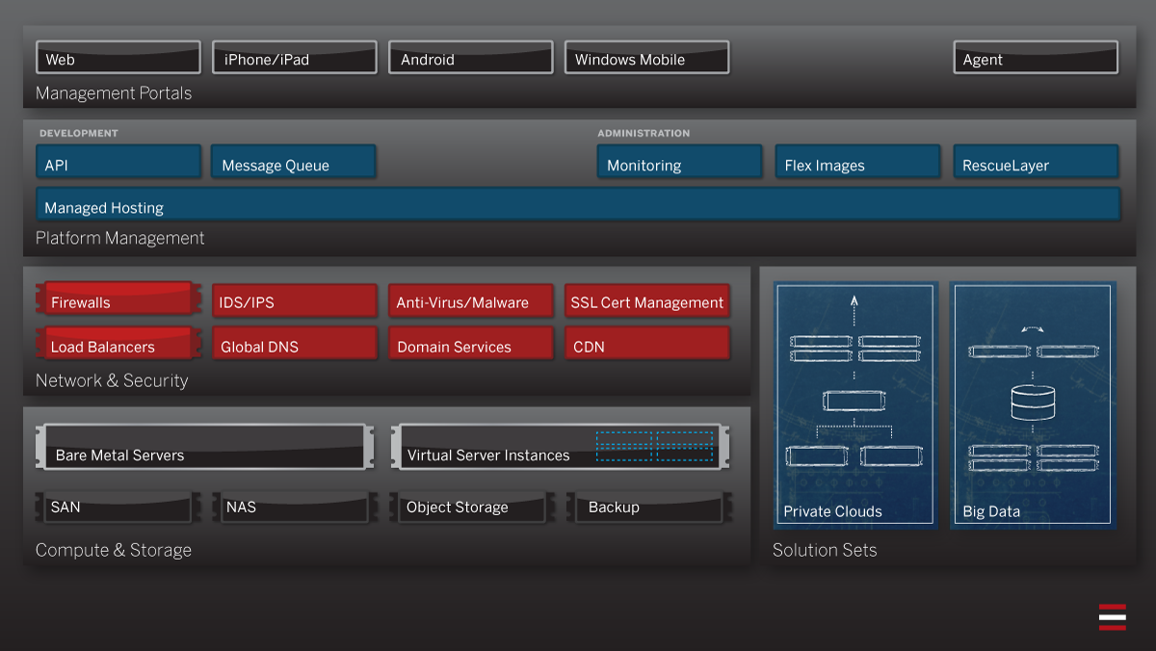
Service portfolio
Notes:
What infrastructure products and services live on SoftLayer’s on-demand global cloud platform? The simple answer is “all of them.” We built our platform for Internet scale, and when we talk about “Internet Scale,” we’re talking about supporting companies whose apps have a few thousand users one day and a few million the next. To accommodate that kind of spike in demand, we knew that every service in our portfolio had to be automated and had to work well together.
To understand the big picture of what that automation looks like from a service perspective, we can break out SoftLayer’s service portfolio into a few logical segments and touch on common customer use cases as well as SoftLayer differentiators.

Slide 18
Compute & Storage
Public Cloud Instances
Virtual server instances
Dedicated physical nodes available
Bare Metal Servers
Dedicated servers deployed on demand
Hourly & monthly pricing
Complete range of options
GPU servers for HPC
Private Clouds
Support for multiple virtualization platforms
Turnkey solution for Citrix CloudPlatform
Multiple local storage options
SAS
SATA
SSD
SAN
NAS
QuantaStor Storage Server
Object Storage
Global platform
Meta tagging
Backup services
Notes:
We’ve talked about the high-level differentiators of our cloud computing environment, but let’s drill down into the compute resources available to SoftLayer customers.
Public cloud instances are virtual server instances that live in a multitenant environment. While many of SoftLayer’s competitors use oversubscribed, commodity hardware to run their public cloud environments SoftLayer’s public cloud instances are delivered on the same enterprise-class bare metal as the rest of our service and we provide dedicated physical cores to ensure reliable, predictable performance. Local or remote storage is available. Public cloud instances have the same public/private/management network connectivity and are managed exactly like a bare metal server. Public cloud instances are considered great for quick scalability, but they aren’t the best fit for performance-intensive tasks … That’s where bare metal servers come in.
A bare metal server is exactly what it sounds like: A physical server is racked and ready in our data center, and when a customer orders it, that customer has full control of that hardware … the bare metal. Automatically provision from a broad library of operating system and application templates, or install your own OS and application stack. SoftLayer offers a broad range of bare metal server options to meet each customer’s specific price and performance needs: Choice of processor(s), RAM, RAID controllers, GPUs for high performance computing, and SATA/SCSI/SATA hard drive options allow customers to customize the server’s hardware to specifically meet his or her application’s needs. Off-box storage options include a suite of SAN and NAS products, and a global Object Storage platform with CDN integration that gives you a highly scalable, cost-effective solution for storing large amounts of static data.
How does this all work together? Customers often deploy public cloud instances for web servers while leveraging powerful bare metal servers for database servers, taking advantage of the strengths of each while managing both as an integrated infrastructure. To help streamline the provisioning of the most requested multi-server deployments like private clouds and big data environments, we’ve worked with our partners to build specialized solution sets.
Customers who want the scalability of a cloud environment with the control and isolation of a single-tenant infrastructure choose to create their own private cloud environments on SoftLayer. We support multiple virtualization platforms including VMware, HyperV and XenServer, and we’ve worked with Citrix to create a turnkey solution for CloudPlatform allowing for complete private cloud environments to be provisioned and deployed from an easy-to-use Web interface.

Slide 19
Network & Security
CDN
24 nodes
Secure content management
Load balancing
Local
Global
Citrix Netscaler
Firewalls
Shared
Dedicated
Fortigate Security Appliance
Application acceleration
DNS services
IDS protection and assessment
SSL certificate management
Antivirus & malware protection
Notes:
While our compute and storage resources are our most visible offerings, our extensive suite of network- and security-related services are often just as indispensable for our customers. Several firewall and load balancer options are available to be provisioned and configured quickly by our automated platform, and our CDN allows customers to distribute their content even closer to their end users around the world. We also provide application acceleration, DNS services, IDS protection and assessment, SSL certificate management, and protection against viruses and malware.

Slide 20
Platform Management
Systems Administration
Monitoring packages
Managed hosting
Managed database services
Software
Complete library of OS, database, virtualization and administration software deployable on-demand and by subscription
Flex Images
Imaging & deployment system provides migration, compatibility across bare-metal and virtual servers
Message Queue
Message & notification service for intra-application and inter-system communications
Notes:
The last segment of our service portfolio that we’ll cover is Platform Management. If a customer needs additional help or expertise when it comes to their systems administration, they can enlist our managed hosting team of experts to help them configure, tweak and maintain their environment. Unlike our competitors, we don’t believe managed hosting should be an “all or nothing” decision, so our customers can pick and choose which pieces of their infrastructure they want help with, and they aren’t committed to any long-term contracts.
To further empower our customers, we offer advanced monitoring packages and a complete library of OS, database, virtualization and administration software deployable on-demand and by subscription.
Because public cloud instances and bare metal servers appear identical in our system, we believed they should be identical to our customers as well. In the past, a customer had an “either, or” decision when it came to choosing a virtual or bare metal base for a given server, so we developed a technology called Flex Images to allow users the ability to take a snapshot of a cloud server and deploy it on bare metal (or vice versa).
The final tool you see here is one that we added to our platform specifically for developers. Message Queue is a message and notification service for intra-application and inter-system communications. When an application has several pieces sending data between each other, those exchanges can often be inefficient. Message Queue makes it easy for developers to orchestrate those exchanges better.

Slide 21














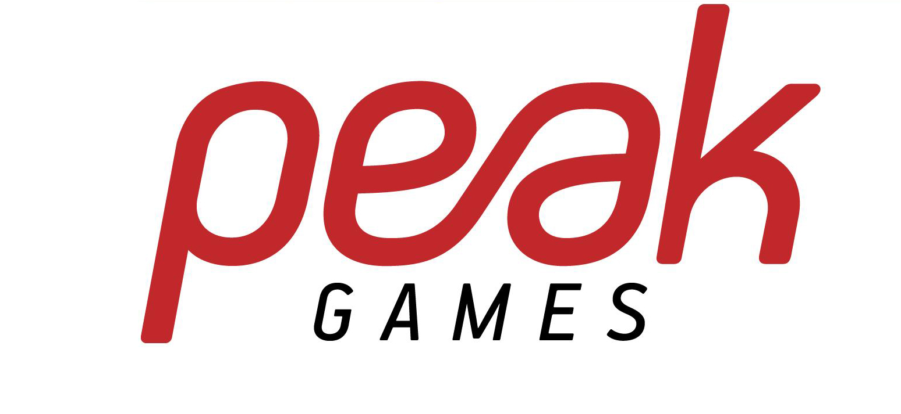












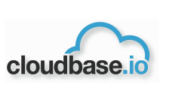









21,000 leading-edge customers*
Mobile & Communications
Software as a Service
Bump
Voxer
Instapaper
Yelp
Games and Entertainment
Social
Marketing and Digital Media
Platform as a Service
Enterprise
Hosting & Service Providers
* SoftLayer references,
Notes:
Finally, a quick look at our customer base will confirm that the innovators, visionaries and leaders building the next-generation of Internet scale apps are coming to SoftLayer.
And this technology is deployed at scale today. Whether it is at companies like:
FitBit . Internet centric companies and products like the Fitbit Tracker, a wireless-enabled wearable device that measures data such as the number of steps walked, quality of sleep, and other personal metrics.
Or Bump an application created by Bump Technologies for the Apple's iOS and Google's Android operating systems, that allows two smartphone users to physically bump their phones together to transfer contact information, photos, and files to each other over the Internet.
But it’s also enterpise companies.. Companies like:
Repsol S.A. a Spanish multinational oil and gas company based in Madrid, Spain. It is the 15th largest petroleum refining company according to the Fortune Global 500 list,^{[3]} employing over 40,000 people worldwide.
Or LAN Airlines S.A. a group of South American Airlines based in Santiago, Chile and part of LATAM Airlines Group, Latin America's largest Airline holding.
So we have internet centric innovators, and game-changing companies – who have built businesses that the world uses every day. Applications that we simply expect to be there – when we want them.. Ready to use… And there are enterprise customers who are using SoftLayer to transform their business, manage costs, drive innovation and stay ahead of the competition.
You can look at the rest of these. What do they have in common?
Internet Scale
Innovation
A reliance on the underlying platform.
That says a lot about the technology that SoftLayer delivers!
Referenced Clients from CMO @ SoftLayer and approved for high-level reference:
SaaS:, BaseCase, HotelsCombined
Social: Path, Slideshare
Mobile: Bump, Fitbit, MagmaMobile
Marketing/Digital Media: Struq, Simpli.fi
Games: KIXEYE, Peak Games, 6waves, Garena
Hosting/Service Providers: ZipServers, MidPhase, Distil Networks, MailChimp
Enterprise (if needed): Repsol, LAN Airlines

Slide 22


Slide 23


Slide 24
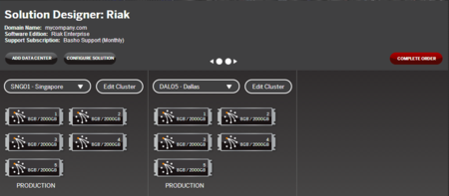


Big Data Solutions
Push-button provisioning of complex, multi-server deployments via online Solution Designer
Support for distributed environments
Solutions leverage performance of local storage and bare-metal compute; outperform commodity public clouds
MongoDB Engineered in partnership with 10gen
Riak Engineered in partnership with Basho
Notes:
To meet the growing demand for high-performance big data environments, we worked with 10gen and Basho to streamline the process of building and growing high-performance MongoDB and Riak solutions built on bare metal servers with local storage, significantly outperforming commodity public clouds running the same software. In the process of building our push-button Solution Designer, we also incorporated best practices for setup and configuration to guarantee the best possible results for our customers.

Slide 25
Managed Production Workload for M&E
Workload Detail
High I/O intensity, Predictable QOE
Supports existing portfolio, license model, and provides platform for future services
Managed Instance
Global reach and load balancing
Use Cases for Industry
Move non differentiated workloads to cloud to allow greater investment in content production.
Softlayer Drivers
Managed Instance
Predictable QOE
Case Studies
Pearson was interested in moving from a traditional outsourcing model to a consumption-based model running in the cloud. Increasing cost pressures was also requiring Pearson to reduce expenses and transfer non differentiating infrastructure to a consumption-based cloud model
The IBM solution involved two phases. The first phase addressed the consolidation of Pearson’s two Mainframes into the IBM z/OS Cloud. The second phase focused on the distributed platforms running in the Pearson NJ . Approximately 700 servers were virtualized and consolidated entire environment was transitioned to a second z/OS cloud datacenter.
IBM BCRS will provide Disaster Recovery Services for both the Mainframe and Distributed environments. BCRS will also provide back-up services for the Distributed environment using managed Back-Up.

Slide 26
Hosted Enterprise Private Clouds
Workload Detail
High I/O intensity, Predictable QOE
Excellent base to build out enterprise PC requirements (HA, data isolation, encryption, reporting, hybrid cloud, etc.)
IBM SCO Openstack and Citrix Private Clouds
Use Cases for Industry
Private hosted cloud for primary and disaster recovery data centers
Softlayer Drivers
Managed Instance
Predictable QOE
High Availability
Case Studies
FINS is a cloud service provider for the network broadcasting companies in Japan. Amid declining advertising revenue, an increase in online advertising and an economic recession, FINS operated servers that ran custom applications. This led to a huge increase in IT costs, even though the client also ran standard applications on existing systems at Fuji Network Systems (FNS) affiliates.
After experiencing the 2011 Japan earthquake, FINS - and its customers - needed reliable, robust systems that would perform better in case of a disaster. Further, FINS did not want to pay large up-front costs to obtain this technology. To meet its objectives, FINS engaged IBM Global Business Services - Application Innovation Services, IBM Global Technology Services - Worldwide Strategic Outsourcing and IBM Global Financing to design, host and finance cloud computing environments for its customers. FINS uses IBM facilities in two separate locations for its primary and disaster recovery data centers. Cache servers remain in the client’s customer's TV stations and are operated remotely by IBM. The Worldwide Strategic Outsourcing team manages the client's customized applications, which enable its customers to develop and broadcast TV program content.

Slide 27
High Performance Computing
Workload Detail
High I/O intensity, Predictable QOS
Dedicated high performance servers and GPUs with cloud flexibility
Load Balancing
GPU offering available
Use Cases for Industry
Transcoding
Infrastructure as a Service
Bare Metal Cloud option
Softlayer Drivers
High I/O intensity
Predictable QOS
Dedicated high performance servers and GPUs with cloud flexibility
Load Balancing
GPU offering available
Case Studies
Flumotion is a leader in online video and audio technology. Flumotion services include acquisition, encoding, automated archiving, multi-format transcoding. Flumotion also provides a cloud-based transcoding service, LiveTranscoding.com, which converts a single live stream into multiple output streams in real-time. LiveTranscoding.com allows content providers and event organizers to reach all devices without making major investments in hardware, software, upgrades, and maintenance. The SaaS solution adapts to the needs of each client, as it can be upgraded or downgraded on a monthly basis. An online portal gives clients real-time control over all their live streams, while providing optimized settings for each combination of format, device, and codec. The company uses SoftLayer’s Bare Metal Cloud option, which is specifically designed for workloads with high input/output. Due to the CPU-intensive nature of the service, the company requires as many CPU cores as possible. Bare Metal Cloud is highly customizable, provisioned in 5–15 minutes, and the perfect solution for LiveTranscoding.com.

Slide 28
Analytics
Workload Detail
High I/O intensity, Predictable QOE
Flexibility to add additional servers/cloud instances
High availability / security
Extensible API for Archiving
Platform Computing
Use Cases for Industry
Audience Insight
Evaluating Campaign Effectiveness
Softlayer Drivers
High I/O intensity
Predictable QOE
Flexibility to add additional servers/cloud instances
High availability / security
Case Studies
A movie studio wanted to utilize social media to understand audience reactions, in real-time, for two film trailers aired during the Super Bowl. After spending roughly $3.5M in ad time for each spot, they needed fast and rich feedback to judge the ad’s effectiveness as well as shape ongoing marketing campaigns
To generate usable business insight from social media, it was not enough to simply track online “buzz”, but required advanced semantic analysis to decipher billions of posts to understand what was being said, who was saying it and why. A Big Data solution was developed and deployed in the cloud to analyze over 1 Billion social media conversations in order to:
Extract conversations about the film and their competition
Determine positive and negative sentiment, overall and for specific elements like the cast, plot, soundtrack and special effects as well summarize what audiences did or didn’t like
Isolate segmentation and demographics details as well as interests such as “avid movie-goers” or “comic book fans” and the specific sentiment of those segments
Identify those intending to see the film in theaters
Identify the most influential participants and whether they were advocating or deterring others from seeing the films
Many competitors offer basic social media sentiment analysis, but IBM’s ability to offer multi-dimensional drill down into segmentation and preferences, and to do so in near real-time, is a potential game changer that creates unique value for marketers industry-wide

Slide 29
Social Business Applications
Workload Detail
High I/O intensity/Load balancing
Integrated dedicated servers and cloud instances
Storage services for files and media
Use Cases for Industry
Softlayer Drivers
High I/O intensity
Predictable QOE
Flexibility to add additional servers/cloud instances
High availability / security
Case Studies
AMC Theatres needed to attract and retain the right people to provide excellent customer service to drive concession sales and cut down on high turnover rates. In addition, AMC didn’t have the right tools in place to effectively measure employee engagement and leadership effectiveness.
AMC turned to Kenexa to study fit in order to find the right candidates who would thrive in the culture of the organization, and to generate leads to find more qualified workers. Kenexa used its Employment Engagement Survey to study AMC’s culture, and then custom-built an assessment solution for general managers. Kenexa also introduced its applicant tracking system to help AMC find candidates who could thrive in its culture.
Theaters led by managers who most closely aligned with the “fit” strategy increased profits per customer by 1.2 percent, which translated into millions of extra dollars of net income.
AMC discovered certain individuals were much more likely to provide a quality guest service experience for its customers.
Concession sales were significantly higher at theaters that were run by a top-performing general manager.
Overall turnover rates at AMC dropped 43 percent, from 127 to 84, during a five-year span.
AMC, through Kenexa’s applicant tracking system, increased candidate leads from 250,000 in 2006 to 1.4 million in a two-year period

Slide 30
Mobile Applications
Workload Detail
High I/O intensity, Predictable QOE
Scale cloud instances in minutes
High performing load balancers for variable demand
Worklight
Use Cases for Industry
Live Events streaming
Second Screen applications
Softlayer Drivers
High I/O intensity
Predictable QOE
Scale cloud instances in minutes
High performing load balancers for variable demand
Worklight
Case Studies
Sporting occasions like the Masters Golf Tournament are by nature unpredictable. A sudden event can generate a sudden burst of activity and interest, and quickly overwhelm unprepared infrastructure. The IBM Events team uses its own private cloud technology to adapt to that demand as needed. New servers can be provisioned quickly and workloads can be moved around uninterrupted to adjust to changing demand. IBM’s cloud can predict, based on many different factors, when more people may be checking in on the Web, their iPads or phones, and dynamically provision resources.
The iPad app developed with Worklight feature an impressive 360-degree panoramic view of different spots on the course that takes advantage of the device’s gyroscope capability. Turn it around and you can better understand from the point of view of the player you happen to be watching on TV at that moment the degree of difficulty of the shot he’s trying to make.

Slide 31
Dev / Test
Workload Detail
High I/O intensity, Predictable QOE
Elasticity of offering
Promotion via cloud of application lifecycle
Dev Ops
Use Cases for Industry
Dev / Test Cloud
Softlayer Drivers
High I/O intensity
Predictable QOE
Elasticity of offering
Promotion via cloud of application lifecycle
Dev Ops
Case Studies
The Digital Media Initiative is a transformation program within the BBC to move from a video tape & analogue based distributed business to a fully digital and online one. IBM is responsible for the Enterprise Archive component, named Enterprise Media & Metadata Management (EM3).
The BBC Digital Media Initiative (DMI) Enterprise Media and Metadata Management (EM3) project utilized IBM's development and system testing (dev/test) capabilities on the IBM Dev/Test cloud.

Slide 32
Web Applications – E commerce
Workload Detail
High I/O intensity, Predictable QOS
Rapid expansion to meet market demand
Integrated dedicated servers and cloud instances
Use Cases for Industry
E-business platform to serve new and existing customers with the latest in coupon, discount, multi-storefront, promotion, or campaign functionality.
Softlayer Drivers
High I/O intensity
Predictable QOS
Rapid expansion to meet market demand
Integrated dedicated servers and cloud instances
Case Studies
Cengage Learning implemented an Online Retail Store and ran into the following issues:
Changing product portfolio with acquisitions
Not many merchandising options on old portal
No promotional ads capabilities
Limited Global Reach / Regional Presence
Lack of Data for Analytics
Emerging competition
Traditional Shopping Experience to users
A Smarter Commerce Solution was developed to put Cengage’s customer in the center of their business engagement. Students were now able to enjoy a One Stop Shopping experience where they could browse, purchase/rent, view and access study material all in one place. The smarter commerce solution also offered a wide range of discounted product purchase options and operates in Global Markets with regional products.

